Slide 1
The latest activities related to the passive components in JAXA
17th October 2024
Japan Aerospace Exploration Agency (JAXA)
Kensuke SHIBA and Koichi SUZUKI

Slide 2
Contents
Introduction of JAXA qualified passive components
Comparison of JAXA/ESCC qualification test specification
Recent activity of passive components
Summary

Slide 3




Introduction of JAXA qualified passive components
JAXA has the components qualification system for components applied to the space application.
Main purpose of this system
Components applied in common for many satellites are treated as standard components.
Quality and reliability of standard components are totally confirmed by this system in advance.
Qualification test (QT), Screening test, Stability of Manufacture product line
Projects which plan to use such a standard components do not need any test before using.
ESA and NASA have similar qualification system.

Slide 4
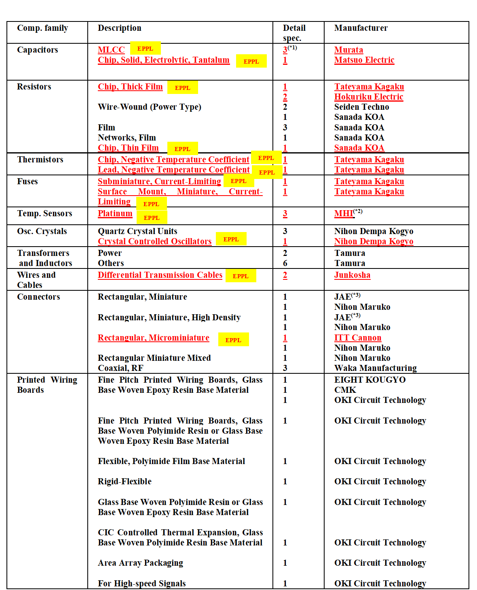
Introduction of JAXA qualified passive components
There are total of 121 models of JAXA qualified components, of which 104 models are passive components.
Table 1. List of JAXA qualified passive components.
※ PCBs and materials such as thermal control films are also included in JAXA qualified components.
As of July 2024, there are 17 passive component manufacturers whose abilities to manufacture the products to satisfy the requirements for space application defined by JAXA.
^{(*1)} NASDA2040/L104(X7R)type and JAXA2040/M105(X7R) type only
^{(*2)} MHI = Mitsubishi Heavy Industries
^{(*3)} JAE = Japan Aviation Electronics Industry

Slide 5
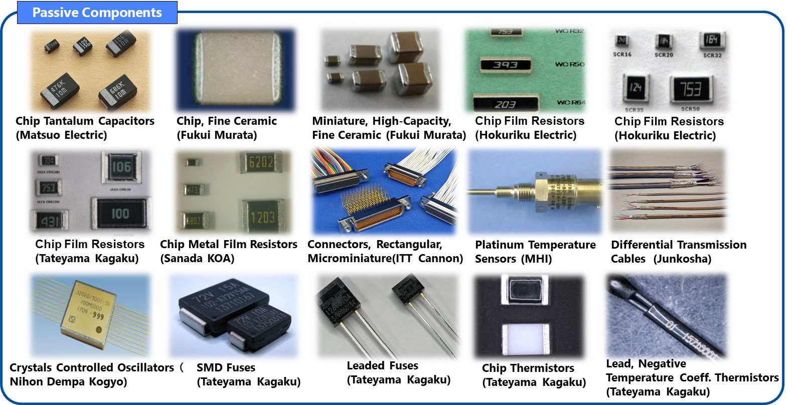
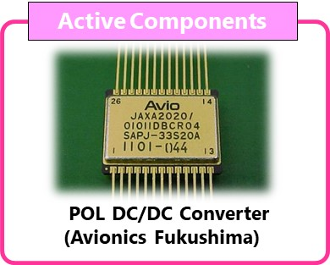
JAXA qualified components listed in EPPL
19 models of JAXA qualified components are listed in EPPL.
: 3 models
: 2 models

Slide 6
Comparison of JAXA/ESCC qualification specification
Like examples of JAXA qualified components listed in EPPL, JAXA and ESA conducted the activity related to the Cooperation Agreement on EEE Components for mutual usage of each component.
Mutual usage of Japanese components in Europe / European components in Japan has been promoted by ESA and JAXA:
    To avoid duplicated development of similar components in Europe / Japan
    To ensure the availability of second source
To remove the barrier of mutual usage, ESA and JAXAA held joint work to compare JAXA specifications and ESCC specifications for component qualification.
Items to be compared
1. Overall difference in both qualification systems
2. Detail comparison of generic specifications

Slide 7
Comparison of JAXA/ESCC qualification specification
Comparison of document tree related to the qualification systems between JAXA and ESA is shown in Fig.1.
Same document tree from Level 2 to Level 4
Fig.1 document tree of JAXA qualification system and ESCC qualification system

Slide 8
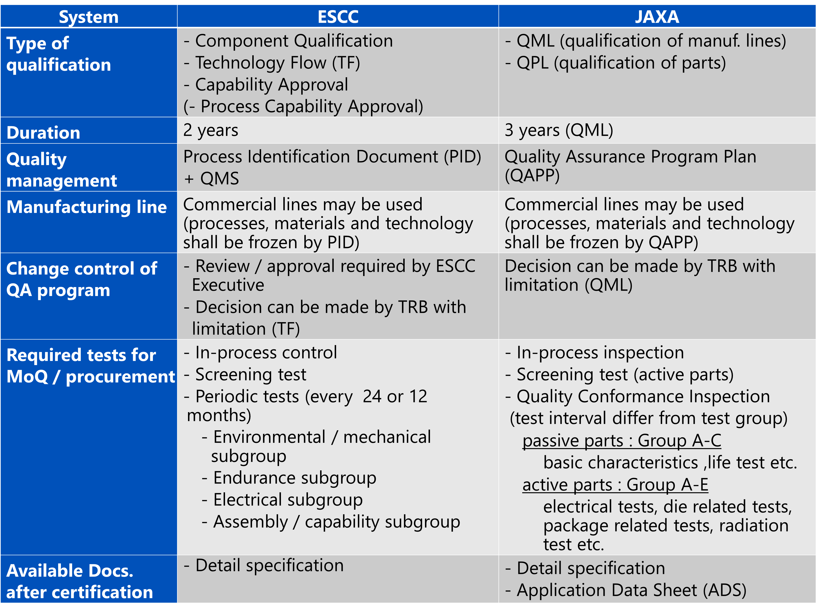
Comparison of JAXA/ESCC qualification specification
Summary of the overall comparison each qualification system are listed in Table 2.
There is no major difference when compared JAXA system with ESCC system.
Table 2. comparison JAXA/ESCC qualification system
MoQ=Maintenance of Qualification QMS=Quality Management System

Slide 9
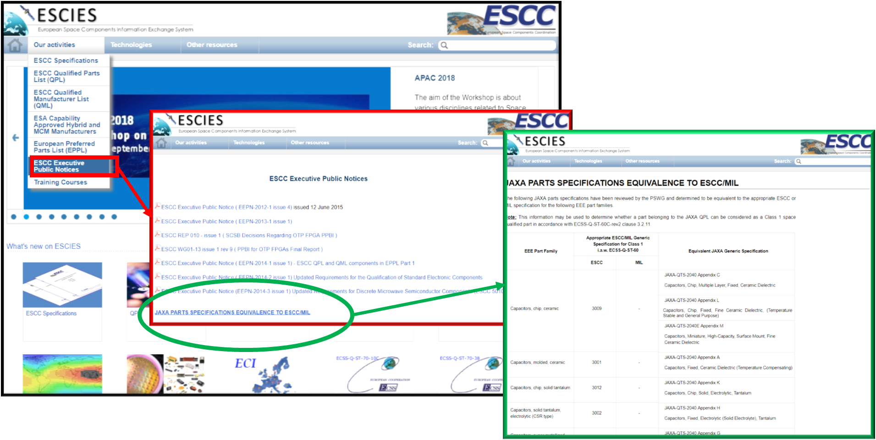

Comparison of JAXA/ESCC qualification specification
Generic specification documents of all JAXA qualified components were compared
with ESCC’s specification. (26 items’ equivalence has been confirmed)
Comparison results are indicated in ESCIES.org (ESCC Public domain website).
https://escies.org/

Slide 10
Recent activities of passive components
<Background>
Commercial Off-The-Shelf (COTS) components, especially for automotive or industrial, are expected to apply to the latest space applications due to its advantage of performance and cost.
However, since COTS components don't conform to space standards, COTS components must be evaluated according to the reliability and quality assurance requirements.
Currently, JAXA does not have the latest passive COTS component evaluation guidelines.
Therefore, in order to prepare the evaluation guidelines for space use of passive COTS components such as polymer tantalum capacitor, solid state battery and stacked metallized film chip capacitor, voltage-controlled crystal oscillator, we have started evaluation activity for tolerance to space environment.
At SPCD2022, we presented the results of structural and material analysis of the four parts mentioned above.
This time, we conducted TID tests, thermal environment tests, and mechanical stress tests to evaluate the concerns extracted from results of structural and material analyses and present the test results here.

Slide 11
Recent activities of passive components
<Samples under tests>
To evaluate the tolerance to the space environment, we prepared 3pcs of each component type for each test. The list of the components are shown in Table 3.
Table 3. The list of the components
Component type | Characteristics | Sample size
Polymer tantalum capacitor | -Rated voltage: 10V -Nominal capacitance: 150µF -Operating temperature range: - 55℃ ~ +105℃ | 3pcs per test
Stacked metallized film chip capacitor | -Rated voltage: 100V -Nominal capacitance: 0.018µF -Capacitance tolerance: ±10% -Operating temperature range: - 55℃ ~ +125℃ | 3pcs per test
Voltage-controlled crystal oscillator | -Nominal frequency: 100, 122.8, 125MHz -Rated voltage: 3.3V -Operating temperature range: 0℃ ~ +70℃, -40℃ ~ +85℃ | 3pcs per test
Solid-state battery | -Rated voltage: 1.5V -Capacity: 100µAh -Dimensions (L×W×H mm): 4.4 x 3.0 x 1.1 mm -Operating temperature range: - 20℃ ~ +80℃ | 3pcs per test
The results for each component are shown on the following pages.

Slide 12
(1) TID tests
Test conditions
We performed TID tests under the test conditions shown in Table 4.
The test facility was the National Institutes for Quantum Science and Technology, the radiation source was cobalt 60, and the dose rate was set at approximately 20k rads(Si)/hour.
Table. 4. TID test conditions
Component type | Conditions | Characteristic evaluation items | Criteria
Polymer tantalum capacitor | -Source: Cobalt 60 -Dose Rate: approximately 20k rads (Si) /hour -Dose: 100k rads (Si) -Characterization: Pre-irradiation, 0.1, 0.3, 0.5, 1.0 (Si) [kGy] -Bias of during irradiation | -Capacitance (Cap.) -Dissipation factor (tanδ) -leakage current | -Capacitance: within ±10% of initial value -Dissipation factor: 0.15 or less -leakage current: 450μA or less
Stacked metallized film chip capacitor |  | -Capacitance (Cap.) -Dissipation factor (tanδ) -Insulation resistance (IR) | -Capacitance: within ±5% of initial value -Dissipation factor: 0.012 or less - Insulation resistance: 1000MΩ or more
Voltage-controlled crystal oscillator |  | -Output frequency -Current consumption | -Output Frequency (Δf/f): ±50 ppm -Current consumption: Maximum 2x the nominal value
Solid-state battery | -Source: Cobalt 60 -Dose Rate: approximately 20k rads (Si) /hour -Dose: 100k rads (Si) -Characterization: Pre-irradiation, 1.0 (Si) [kGy] -Bias of during irradiation | -discharge capacity | -discharge capacity: N/A(Charge/discharge characteristic data acquisition only)

Slide 13
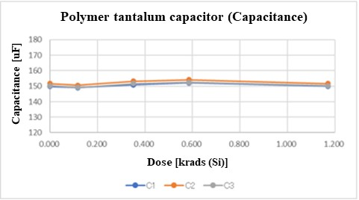
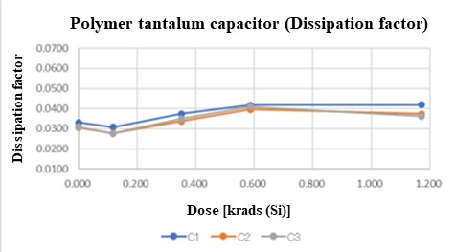
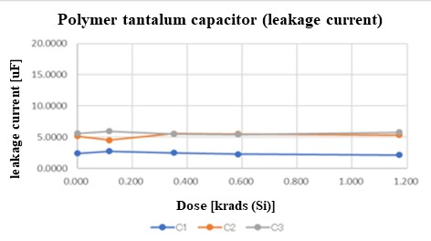
(1) TID tests
Polymer tantalum capacitor
The results of the electrical characteristic measurements after the TID test on the polymer tantalum capacitor are shown in Fig. 2.
No significant changes or abnormalities in electrical characteristics due to irradiation were observed.
    Capacitance: No abnormalities as the maximum change was 1.61% compared to the judgment criteria of ±10% change rate from the initial value.
    Dissipation factor: No abnormalities as the maximum value was 0.04176, compared to the judgment criteria of 0.15 or less.
    Leakage current: No abnormalities as the maximum value was 5.9μA, compared to the judgment criteria of 450μA or less.
ALL
GOOD
Fig. 2. The results of the electrical characteristic measurements after the TID test on the polymer tantalum capacitor

Slide 14
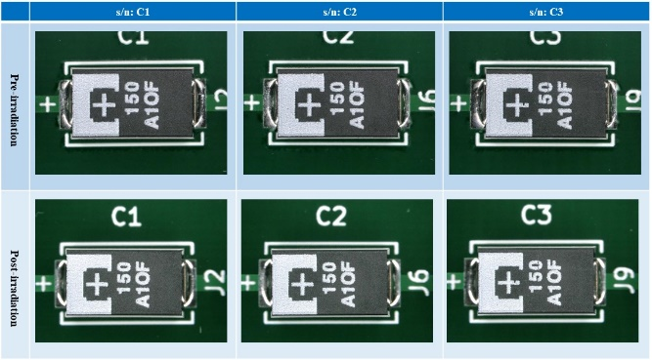
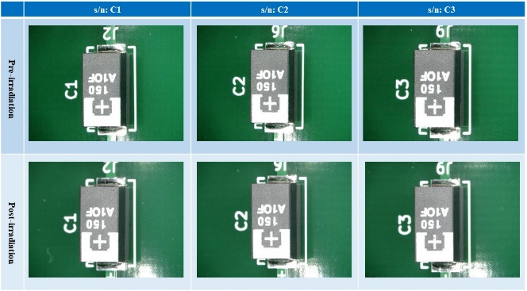
(1) TID tests
Polymer tantalum capacitor (cont’d)
The results of the external visual examination after irradiation are shown in Fig. 3.
No significant changes or abnormalities were observed.
ALL
GOOD
TOP
Tilt 45°
Fig. 3. The results of the external visual examination after irradiation on the polymer tantalum capacitor

Slide 15
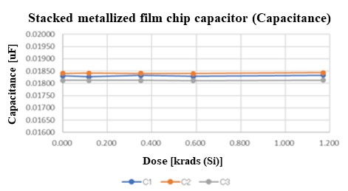
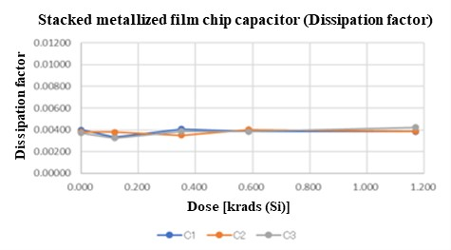
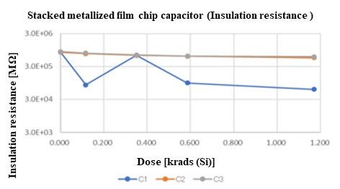
(1) TID tests
Stacked metallized film chip capacitor
The results of the electrical characteristic measurements after the TID test on the stacked metallized film chip capacitor are shown in Fig. 4.
No significant changes or abnormalities in electrical characteristics due to irradiation were observed.
    Capacitance: No abnormalities as the maximum change was -0.21% compared to the judgment criteria of ±5% change rate from the initial value.
    Dissipation factor: No abnormalities as the maximum value was 0.0422, compared to the judgment criteria of 0.12 or less.
    Insulation resistance: No abnormalities as the minimum value was 61,000MΩ, compared to the judgment criteria of 1,000MΩ or more.
ALL
GOOD
Fig. 4. The results of the electrical characteristic measurements after the TID test on the stacked metallized film chip capacitor

Slide 16
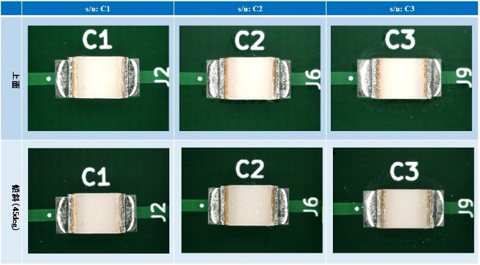
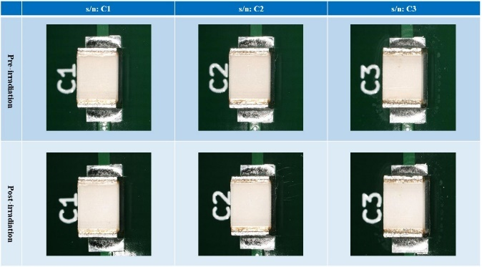
(1) TID tests
Stacked metallized film chip capacitor (cont’d)
The results of the external visual examination after the TID test are shown in Fig. 5.
No significant changes or abnormalities were observed.
ALL
GOOD
TOP
Tilt 45°
Fig. 5. The result of external visual examination after the TID test on the stacked metallized film chip capacitor

Slide 17
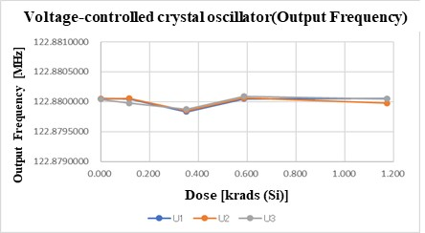
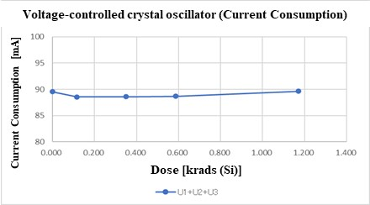
(1) TID tests
Voltage-controlled crystal oscillator
The results of the electrical characteristic measurements after the TID test on the voltage-controlled crystal oscillator are shown in Fig. 6.
No significant changes or abnormalities in electrical characteristics due to irradiation were observed.
    output frequency: No abnormalities as the maximum change was 166Hz compared to the judgment criteria of 122.88MHz±6.144kHz.
    Current consumption: No significant changes, so no abnormalities.
ALL
GOOD
Fig. 6. The results of the electrical characteristic measurements after the TID test on the voltage-controlled crystal oscillator

Slide 18
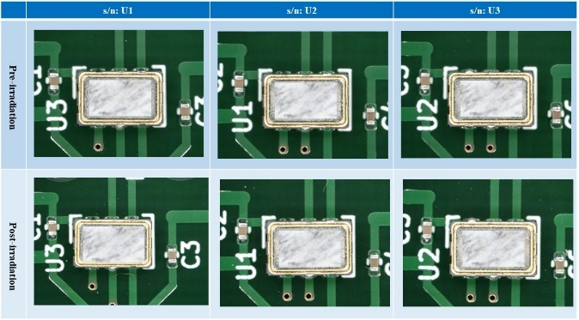
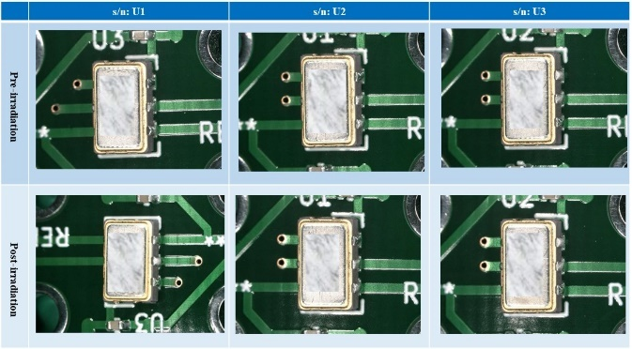
(1) TID tests
Voltage-controlled crystal oscillator (cont’d)
The results of the external visual examination after the TID test are shown in Fig. 7.
No significant changes or abnormalities were observed.
ALL
GOOD
TOP
Tilt 45°
Fig. 7. The results of the external visual examination after irradiation on the voltage-controlled crystal oscillator

Slide 19
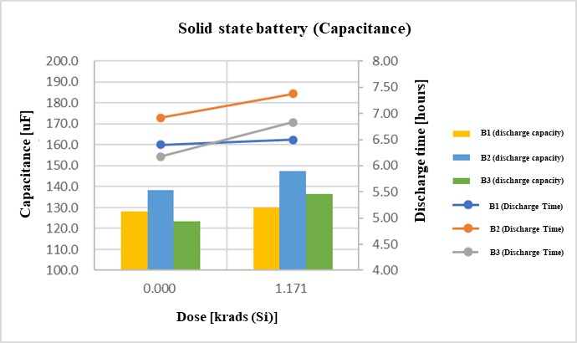
(1) TID tests
Solid-state battery
The result of the electrical characteristic measurements after the TID test on the solid-state battery is shown in Fig. 8.
No significant changes or abnormalities in the capacitance measurement result.
GOOD
Fig. 8. The result of the electrical characteristic measurements after the TID test on the solid-state battery

Slide 20
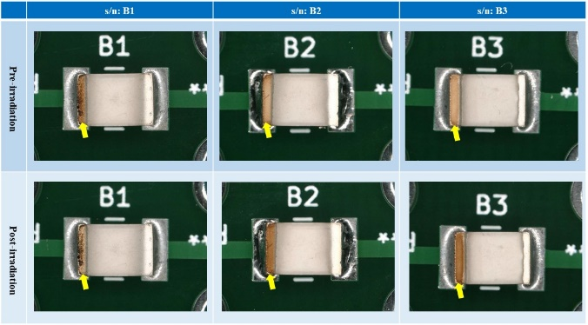
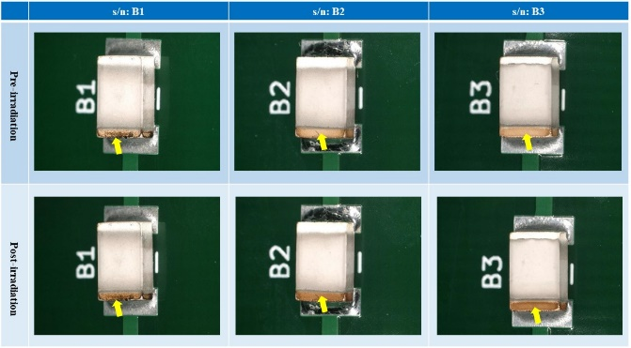
(1) TID tests
Solid-state battery (cont’d)
The results of the external visual examination after the TID test are shown in Fig. 9.
During charging and discharging before irradiation, discoloration (brown) was confirmed in the negative electrode. The browned area is indicated by the yellow arrow in the figure.
Regarding the browning of the negative electrode, we performed an elemental analysis of the electrode surface. We confirmed that there was a lot of oxygen in the browned area, and that carbon was present along with the oxygen. From this, we believe that the browning of the negative electrode was caused by oxidation due to reactions with the solder flux.
TOP
Tilt 45°
Fig. 9. The results of the external visual examination after irradiation on the solid-state battery

Slide 21
(2) Mechanical stress tests
Test conditions
We performed the mechanical stress tests under the test conditions shown in Table 5(Vibration tests) and Table 6(Shock tests).
Table. 5. Vibration test conditions
Component type | Conditions | Characteristic evaluation items | Criteria
Polymer tantalum capacitor | -Test method: MIL-STD-202, TM214 -Test condition: condition Ⅱ, H (34.02Grms) -Frequency: 50Hz ~ 2,000Hz -Test time: 3 minutes for each on 3 axes, 9 minutes in total. -Characterization: Pre, Post-Vibration, Post-Shock | -Capacitance (Cap.) -Dissipation factor (tanδ) -leakage current | -Capacitance: within ±10% of initial value -Dissipation factor: 0.15 or less -leakage current: 450μA or less
Stacked metallized film chip capacitor |  | -Capacitance (Cap.) -Dissipation factor (tanδ) -Insulation resistance (IR) | -Capacitance: within ±3% of initial value -Dissipation factor: 0.011 or less - Insulation resistance: 3000MΩ or more
Solid-state battery |  | -discharge capacity | -discharge capacity: N/A (Charge/discharge characteristic data acquisition only)
Voltage-controlled crystal oscillator | -Test method: MIL-STD-883, TM2007 -Test condition: condition A (20G) -Frequency: 20Hz ~ 2,000Hz -Test time: 4 minutes for each on 3 axes, 4 times, 48 minutes in total. -Characterization: Pre, Post-Vibration, Post-Shock | -Output frequency -Current consumption | -Output Frequency (Δf/f): ±50 ppm -Current consumption: Maximum 2x the nominal value

Slide 22
(2) Mechanical stress tests
Test conditions (cont’d)
We conducted the mechanical stress tests under the test conditions shown in Table 5(Vibration tests) and Table 6(Shock tests).
Table. 6. Shock test conditions
Component type | Conditions | Characteristic evaluation items | Criteria
Polymer tantalum capacitor | -Test method: MIL-STD-202, TM213 -Test condition: condition C (100G) -Duration of pulse: 6 msec -Waveform: Half-sine shock pulse -Characterization: Pre, Post-Vibration, Post-Shock | -Capacitance (Cap.) -Dissipation factor (tanδ) -leakage current | -Capacitance: within ±10% of initial value -Dissipation factor: 0.15 or less -leakage current: 450μA or less
Stacked metallized film chip capacitor |  | -Capacitance (Cap.) -Dissipation factor (tanδ) -Insulation resistance (IR) | -Capacitance: within ±5% of initial value -Dissipation factor: 0.012 or less - Insulation resistance: 1000MΩ or more
Solid-state battery |  | -discharge capacity | -discharge capacity: N/A (Charge/discharge characteristic data acquisition only)
Voltage-controlled crystal oscillator | -Test method: MIL-STD-883, TM2007 -Test condition: condition A (20G) -Frequency: 20Hz ~ 2,000Hz -Test time: 4 minutes for each on 3 axes, 4 times, 48 minutes in total. -Characterization: Pre, Post-Vibration, Post-Shock | -Output frequency -Current consumption | -Output Frequency (Δf/f): ±50 ppm -Current consumption: Maximum 2x the nominal value

Slide 23
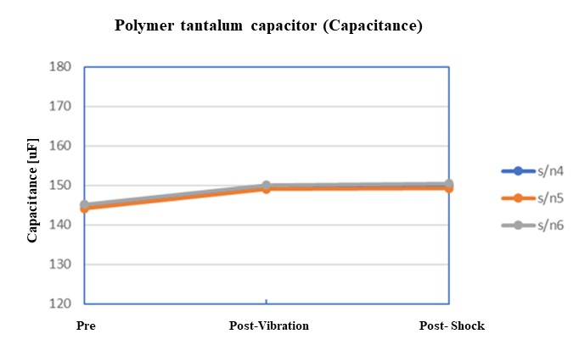
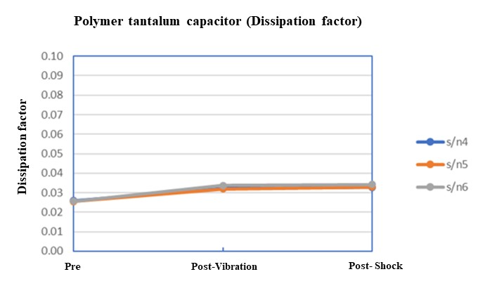
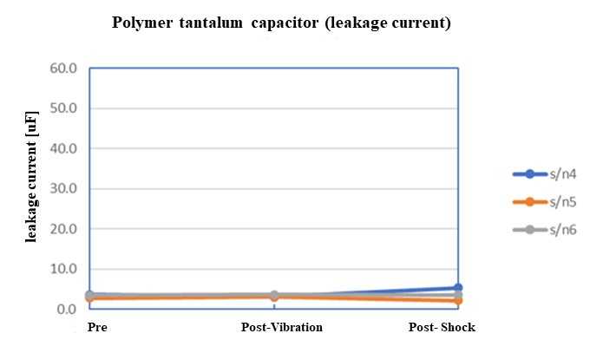
(2) Mechanical stress tests
Polymer tantalum capacitor
The results of the electrical characteristic measurements after the vibration test and shock test on the polymer tantalum capacitor are shown in Fig. 10.
No significant changes or abnormalities in electrical characteristics due to vibration and shock were observed.
    Capacitance: No abnormalities as after the vibration and the shock test the maximum change was 3.57% compared to the judgment criteria of ±10% change rate from the initial value
    Dissipation factor: No abnormalities as after the vibration and the shock test the maximum change was 0.0343 compared to the judgment criteria of 0.15 or less.
    Leakage current: No abnormalities as after the vibration test and the shock test the maximum value was 5.26μA, compared to the judgment criteria of 450μA or less.
ALL
GOOD
Fig. 10. The results of the electrical characteristic measurements after the vibration test and shock test on the polymer tantalum capacitor

Slide 24
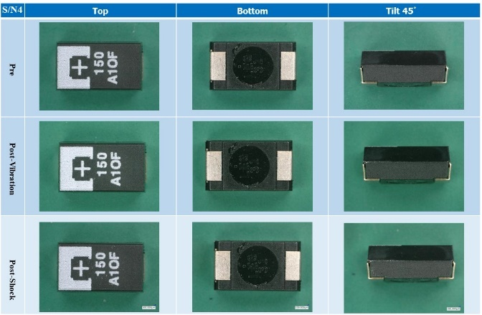
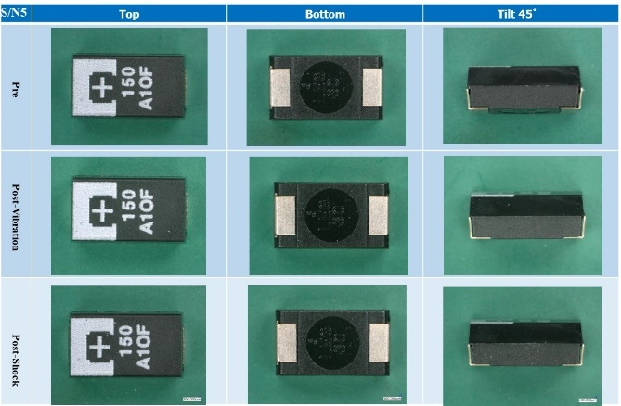
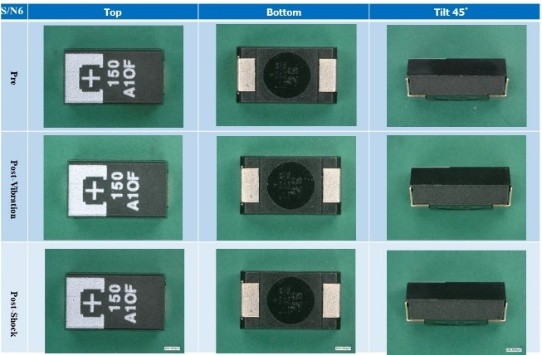
(2) Mechanical stress tests
Polymer tantalum capacitor (cont’d)
The results of the external visual examination after the vibration test and the shock test are shown in Fig. 11.
No significant changes or abnormalities were observed.
ALL
GOOD
S/N:4
S/N:5
S/N:6
Fig. 11. The results of the external visual examination after the vibration test and shock test on polymer tantalum capacitor

Slide 25
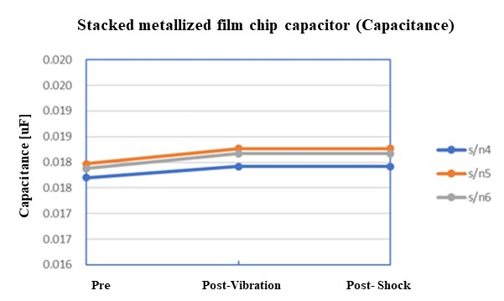
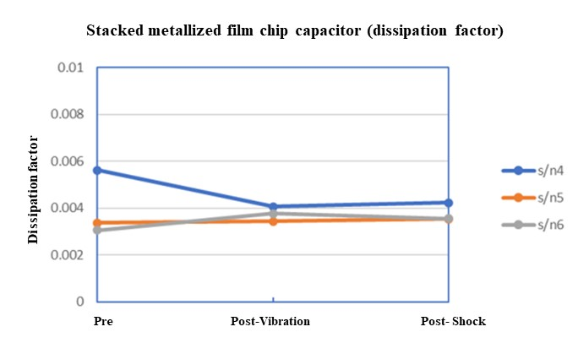
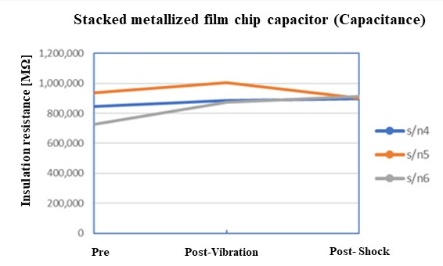
(2) Mechanical stress tests
Stacked metallized film chip capacitor
The results of the electrical characteristic measurements after the vibration test and Shock test on the stacked metallized film chip capacitor are shown in Fig. 12.
No significant changes or abnormalities in electrical characteristics due to vibration and shock were observed.
    Capacitance: No abnormalities as the maximum change was -0.21% compared to the judgment criteria of ±3% change rate from the initial value.
    Dissipation factor: No abnormalities as the maximum value was 0.0422, compared to the judgment criteria of 0.12 or less.
    Insulation resistance: No abnormalities as the minimum value was 61,000MΩ, compared to the judgment criteria of 1,000MΩ or more.
ALL
GOOD
Fig. 12. The results of the electrical characteristic measurements after the vibration test and shock test on the stacked metallized film chip capacitor

Slide 26
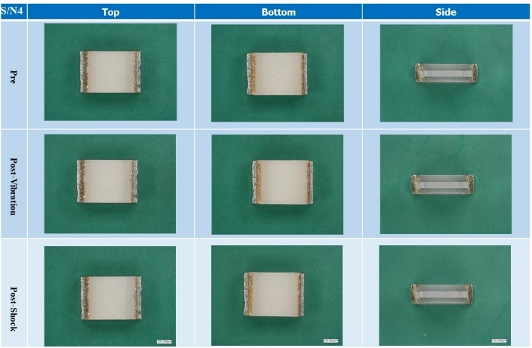
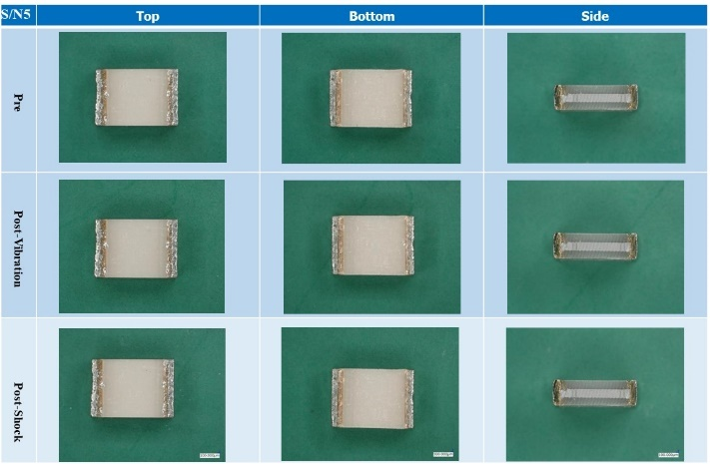
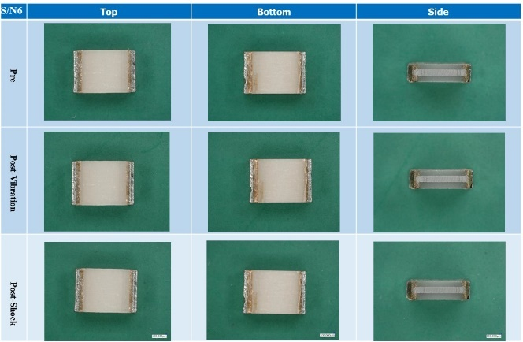
(2) Mechanical stress tests
Stacked metallized film chip capacitor (cont’d)
The results of the external visual examination after the vibration test and shock test are shown in Fig. 13.
No significant changes or abnormalities were observed.
ALL
GOOD
S/N:4
S/N:5
S/N:6
Fig. 13. The results of the external visual examination after the vibration test and shock test on the stacked metallized film chip capacitor

Slide 27
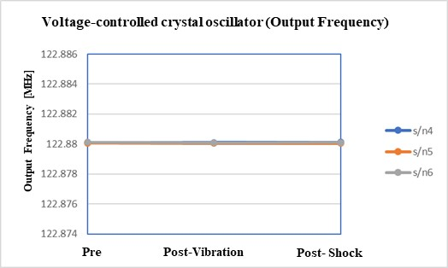
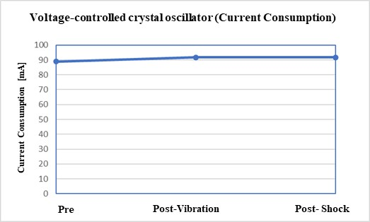
(2) Mechanical stress tests
Voltage-controlled crystal oscillator
The results of the electrical characteristic measurements after the vibration test and shock test on the voltage-controlled crystal oscillator are shown in Fig. 14.
No significant changes or abnormalities in electrical characteristics due to vibration and shock were observed.
    output frequency: No abnormalities as the maximum change was 137Hz compared to the judgment criteria of 122.88MHz±6.144kHz.
    Current consumption: No significant changes, no abnormalities.
ALL
GOOD
Fig. 14. The results of the electrical characteristic measurements after the vibration test and shock test on the voltage-controlled crystal oscillator

Slide 28
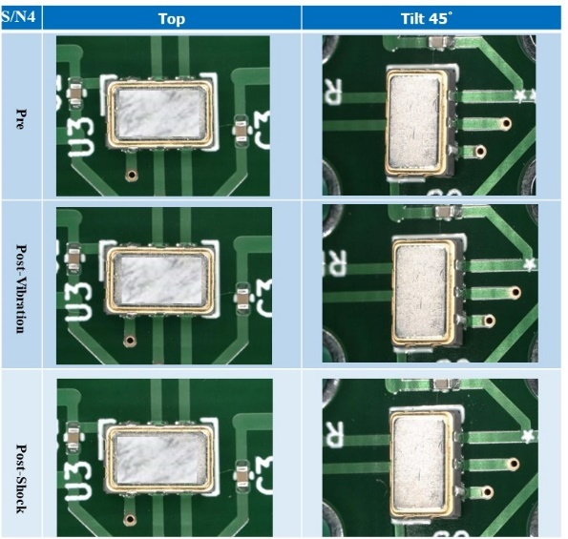
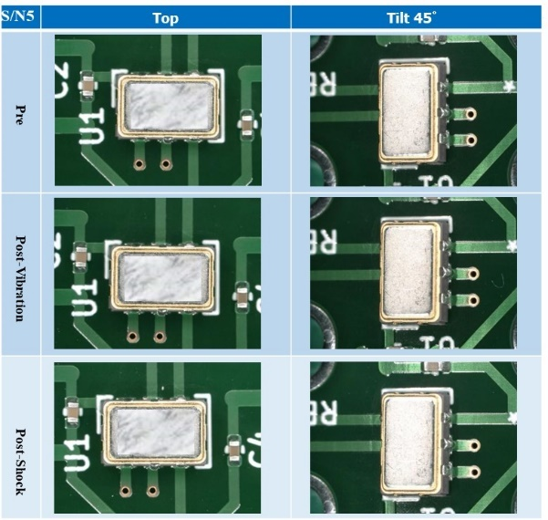
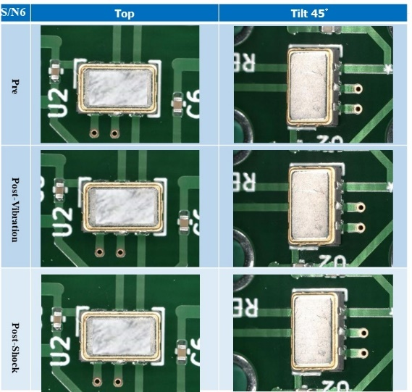
(2) Mechanical stress tests
Voltage-controlled crystal oscillator (cont’d)
The results of the external visual examination after the vibration test and the shock test are shown in Fig. 15.
No significant changes or abnormalities were observed.
ALL
GOOD
S/N:4
S/N:5
S/N:6
Fig. 15. The results of the external visual examination after the vibration test and the shock test on the voltage-controlled crystal oscillator

Slide 29
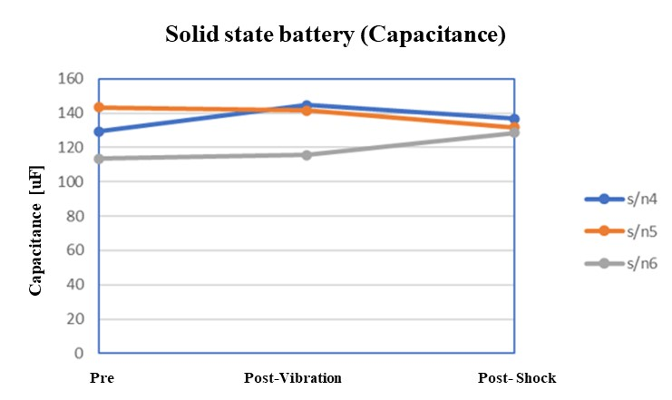
(2) Mechanical stress tests
Solid-state battery
The result of the electrical characteristic measurements after the vibration test and shock test on the solid-state battery is shown in Fig. 16.
No significant changes or abnormalities in electrical characteristics due to vibration and shock were observed.
GOOD
Fig. 16. The result of the electrical characteristic measurements after the TID test on the solid-state battery

Slide 30
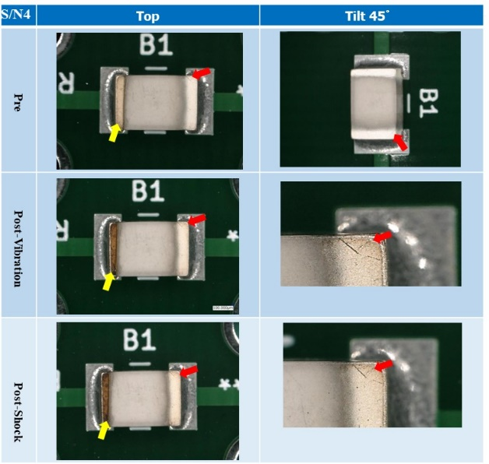
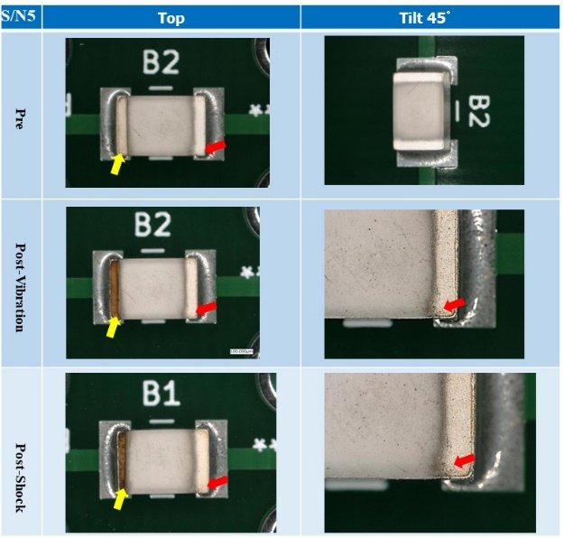
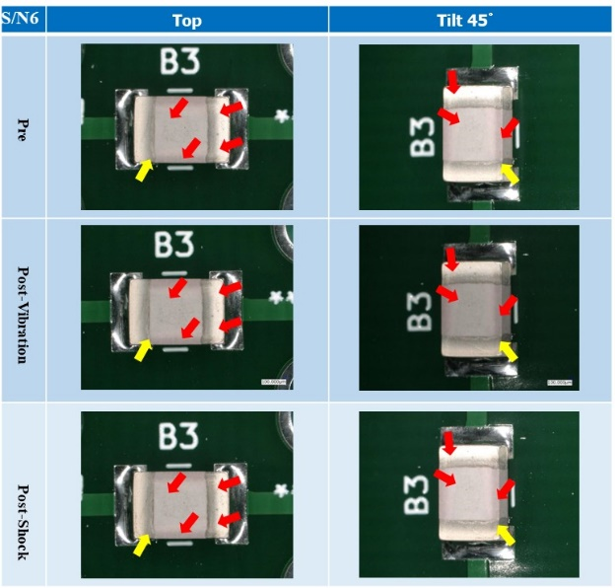
(2) Mechanical stress tests
Solid-state battery (cont’d)
The results of the external visual examination after the vibration test and the shock test are shown in Fig. 17.
During charging and discharging before the vibration test, discoloration (brown) at the negative electrode and cracks at the electrodes and body were observed. The browned area is indicated by the yellow arrow and the crack area is indicated by the red arrow in the figure.
S/N:4
S/N:5
S/N:6
Fig. 17. The results of the external visual examination after the vibration test and the shock test on solid-state battery

Slide 31
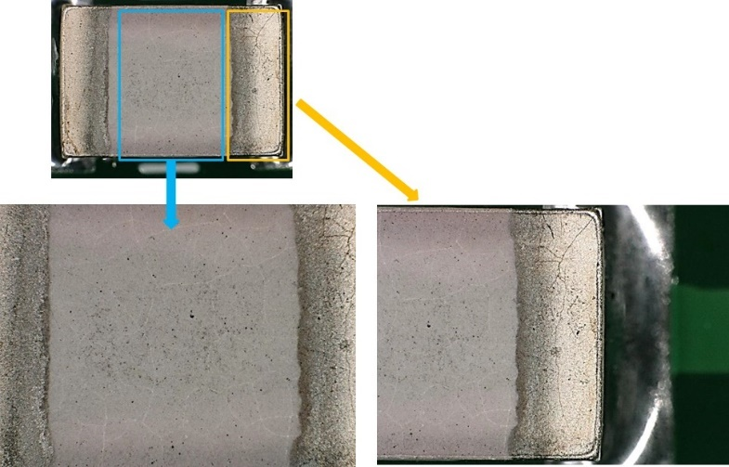
(2) Mechanical stress tests
Solid-state battery (cont’d)
Close-up images of the area where cracks occurred in the S/N6 sample after the shock test is shown in Figure 18. Cracks occurred throughout the electrodes and the body.
According to the manufacturer, cracks occur due to volume changes during charging and discharging.
Fig. 18. Close-up images of the area where cracks occurred in the S/N6

Slide 32
(3) Thermal environment tests
Test conditions
We conducted thermal environment tests under the test conditions shown in Table 7(Thermal shock tests) and Table 8(Ion migration tests).
Table. 8. Thermal shock tests conditions
Component type | Conditions | Characteristic evaluation items | Criteria
Polymer tantalum capacitor | -Test method: MIL-STD-202, TM107 -Test cycles: -40℃(30min) → R.T.(5min) → +100℃(30min), 1000cycles -Characterization: Pre, 100, 300, 500, 1000cycles | -Capacitance (Cap.) -Dissipation factor (tanδ) -leakage current | -Capacitance: within ±10% of initial value -Dissipation factor: 0.15 or less -leakage current: 450μA or less
Stacked metallized film chip capacitor |  | -Capacitance (Cap.) -Dissipation factor (tanδ) -Insulation resistance (IR) | -Capacitance: within ±5% of initial value -Dissipation factor: 0.012 or less - Insulation resistance: 1500MΩ or more
Solid-state battery | -Test method: MIL-STD-202, TM107 -Test cycles: -20℃(30min) → R.T.(5min) → +80℃(30min), 1000cycles -Characterization: Pre, 100, 300, 500, 1000cycles | -discharge capacity | -discharge capacity: N/A(Charge/discharge characteristic data acquisition only)
Voltage-controlled crystal oscillator | -Test method: MIL-STD-202, TM107 -Test cycles: -40℃(30min) → R.T.(5min) → +100℃(30min), 1000cycles -Characterization: Pre, 100, 300, 500, 1000cycles | -Output frequency -Current consumption | -Output Frequency (Δf/f): ±50 ppm -Current consumption: Maximum 2x the nominal value

Slide 33
(3) Thermal environment tests
Test conditions (cont’d)
We conducted thermal environment tests under the test conditions shown in Table 7(Thermal shock tests) and Table 9(Ion migration tests).
Table. 9. Ion migration tests conditions
Component type | Conditions | Characteristic evaluation items | Criteria
Polymer tantalum capacitor | -Temperature: +85℃ -Test Time: 2000hours -Vias: 10V(static) -Characterization: Pre, 240, 500, 1000, 2000hours | -Capacitance (Cap.) -Dissipation factor (tanδ) -leakage current | -Capacitance: within ±10% of initial value -Dissipation factor: 0.15 or less -leakage current: 450μA or less
Stacked metallized film chip capacitor |  | -Capacitance (Cap.) -Dissipation factor (tanδ) -Insulation resistance (IR) | -Capacitance: within ±5% of initial value -Dissipation factor: 0.012 or less - Insulation resistance: 1000MΩ or more
Solid-state battery | -Temperature: +80℃ -Test Time: 2000hours -Vias: 100V(static) -Characterization: Pre, 240, 500, 1000, 2000hours | -discharge capacity | -discharge capacity: N/A (Charge/discharge characteristic data acquisition only)
Voltage-controlled crystal oscillator | -Temperature: +85℃ -Test Time: 2000hours -Vias: 2V, -1.3V(static) -Characterization: Pre, 240, 500, 1000, 2000hours | -Output frequency -Current consumption | -Output Frequency (Δf/f): ±50 ppm -Current consumption: Maximum 2x the nominal value

Slide 34
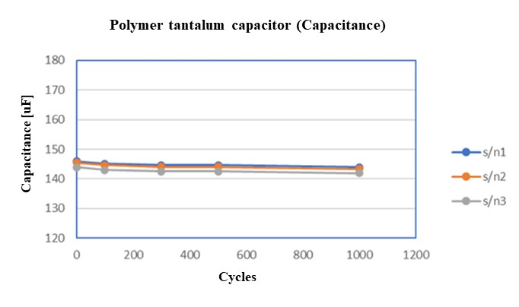
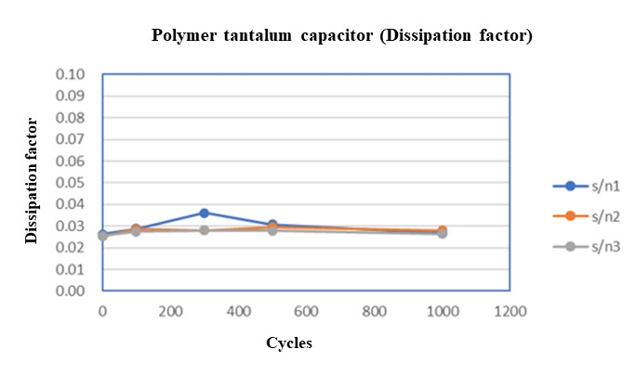
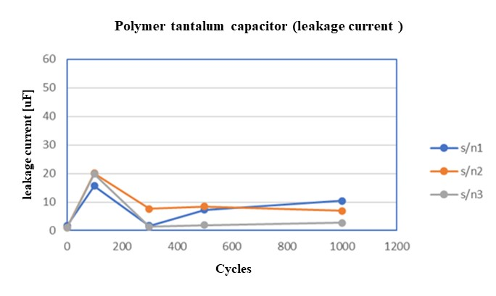
(3) Thermal environment tests
Polymer tantalum capacitor
Thermal shock test
The results of the electrical characteristic measurements after the thermal shock test on the polymer tantalum capacitor are shown in Fig. 19.
No significant changes or abnormalities in electrical characteristics due to thermal shock were observed.
    Capacitance: No abnormalities as the maximum change was 1.47% compared to the judgment criteria of ±10% change rate from the initial value.
    Dissipation factor: No abnormalities as the maximum value was 0.0361, compared to the judgment criteria of 0.15 or less.
    Leakage current: No abnormalities as the maximum value was 20μA, compared to the judgment criteria of 450μA or less.
ALL
GOOD
Fig. 19. The results of the electrical characteristic measurements after the thermal shock test on the polymer tantalum capacitor

Slide 35
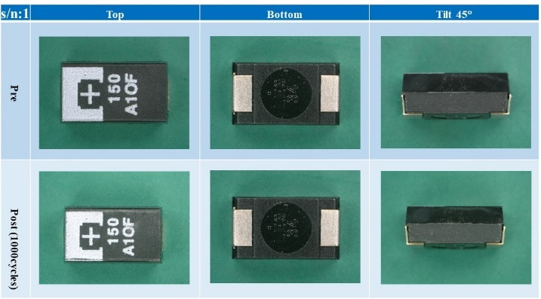
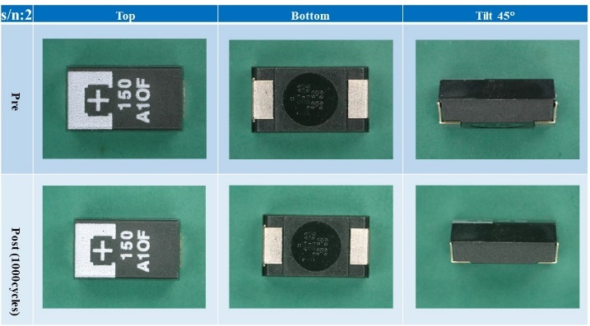
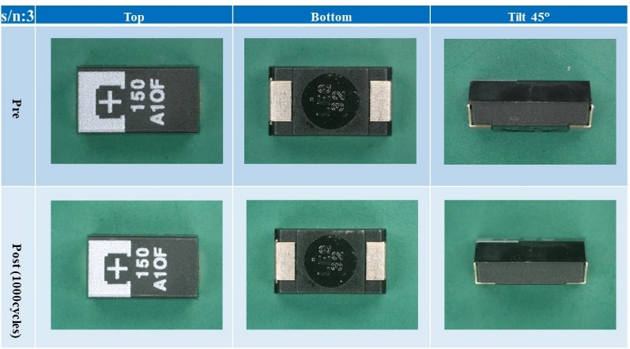
(3) Thermal environment tests
Polymer tantalum capacitor (cont’d)
Thermal shock test
The results of the external visual examination after the thermal shock test are shown in Fig. 20.
No significant changes or abnormalities were observed.
ALL
GOOD
S/N:1
S/N:2
S/N:3
Fig. 20. The results of the external visual examination after the thermal shock test on the polymer tantalum capacitor

Slide 36

(3) Thermal environment tests
Polymer tantalum capacitor (cont’d)
Ion migration test
The result of the ion migration test on the polymer tantalum capacitor are shown in Fig. 21.
For S/N 7, a temporary increase of 0.5μA was observed, but this result was not caused by ion migration. On the other hand, no significant fluctuations were observed for S/N 8 and 9, and no changes of the ion migration were observed.
GOOD
Fig. 21. The result of the ion migration test on the polymer tantalum capacitor

Slide 37



(3) Thermal environment tests
Polymer tantalum capacitor (cont’d)
Ion migration test
The results of the electrical characteristic measurements after the ion migration test on the polymer tantalum capacitor are shown in Fig. 22.
No significant changes or abnormalities in electrical characteristics due to thermal shock were observed.
    Capacitance: No abnormalities as the maximum change was 2.35% compared to the judgment criteria of ±10% change rate from the initial value.
    Dissipation factor: No abnormalities as the maximum value was 0.04, compared to the judgment criteria of 0.15 or less.
    Leakage current: No abnormalities as the maximum value was 17.346μA, compared to the judgment criteria of 450μA or less.
ALL
GOOD
Fig. 22. The results of the electrical characteristic measurements after the ion migration test on polymer tantalum capacitor

Slide 38



(3) Thermal environment tests
Polymer tantalum capacitor (cont’d)
Ion migration test
The results of the external visual examination after the ion migration test are shown in Fig. 23.
No significant changes or abnormalities were observed.
ALL
GOOD
S/N:7
S/N:8
S/N:9
Fig. 23. The results of the external visual examination after the ion migration test on the polymer tantalum capacitor

Slide 39



(3) Thermal environment tests
Stacked metallized film chip capacitor
Thermal shock test
The results of the electrical characteristic measurements after the thermal shock test on the stacked metallized film chip capacitor are shown in Fig. 24.
No significant changes or abnormalities in electrical characteristics due to thermal shock were observed.
    Capacitance: No abnormalities as the maximum change was 0.97% compared to the judgment criteria of ±5% change rate from the initial value.
    Dissipation factor: No abnormalities as the maximum value was 0.033, compared to the judgment criteria of 0.12 or less.
    Insulation resistance: No abnormalities as the minimum value was 1,000,000MΩ, compared to the judgment criteria of 1,500MΩ or more.
ALL
GOOD
Fig. 24. The results of the electrical characteristic measurements after the thermal shock test on the stacked metallized film chip capacitor

Slide 40



(3) Thermal environment tests
Stacked metallized film chip capacitor (cont’d)
Thermal shock test
The results of the external visual examination after the thermal shock test are shown in Fig. 25.
No significant changes or abnormalities were observed.
ALL
GOOD
S/N:1
S/N:2
S/N:3
Fig. 25. The results of the external visual examination after the thermal shock test on stacked metallized film chip capacitor

Slide 41

(3) Thermal environment tests
Stacked metallized film chip capacitor (cont’d)
Ion migration test
The results of the ion migration test on the stacked metallized film chip capacitor are shown in Fig. 26.
No significant fluctuations or signs of the ion migration were observed.
GOOD
Fig. 26. The result of the ion migration test on stacked metallized film chip capacitor

Slide 42



(3) Thermal environment tests
Stacked metallized film chip capacitor (cont’d)
Ion migration test
The results of the electrical characteristic measurements after the ion migration test are shown in Fig. 27.
No significant fluctuations or no signs of the ion migration were observed.
    Capacitance: No abnormalities as the maximum change was 1.88% compared to the judgment criteria of ±5% change rate from the initial value.
    Dissipation factor: No abnormalities as the maximum value was 0.00337, compared to the judgment criteria of 0.012 or less.
    Insulation resistance: No abnormalities as the minimum value was 1,750,000MΩ, compared to the judgment criteria of 1,000MΩ or more.
ALL
GOOD
Fig. 27. The results of the electrical characteristic measurements after the ion migration test on stacked metallized film chip capacitor

Slide 43



(3) Thermal environment tests
Stacked metallized film chip capacitor (cont’d)
Ion migration test
The results of the external visual examination after the ion migration test are shown in Fig. 28.
No significant changes or abnormalities were observed.
ALL
GOOD
S/N:7
S/N:8
S/N:9
Fig. 28. The results of the external visual examination after the ion migration test on stacked metallized film chip capacitor

Slide 44


(3) Thermal environment tests
Voltage-controlled crystal oscillator
Thermal shock test
The results of the electrical characteristic measurements after the thermal shock test on the voltage-controlled crystal oscillator are shown in Fig. 29.
No significant changes or abnormalities in electrical characteristics due to thermal shock were observed.
    output frequency: No abnormalities as the maximum change was 166Hz compared to the judgment criteria of 122.88MHz±6.144kHz.
    Current consumption: No significant changes or abnormalities.
ALL
GOOD
Fig. 29. The results of the electrical characteristic measurements after the thermal shock test on the voltage-controlled crystal oscillator

Slide 45



(3) Thermal environment tests
Voltage-controlled crystal oscillator (cont’d)
Thermal shock test
The results of the external visual examination after the thermal shock test are shown in Fig. 30.
No significant changes or abnormalities were observed.
ALL
GOOD
S/N:1
S/N:2
S/N:3
Fig. 30. The results of the external visual examination after the thermal shock test on voltage-controlled crystal oscillator

Slide 46


(3) Thermal environment tests
Voltage-controlled crystal oscillator (cont’d)
Ion migration test
The results of the ion migration test on the voltage-controlled crystal oscillator are shown in Fig. 31.
No significant fluctuations or signs of the ion migration were observed.
    output frequency: No abnormalities as the maximum change was 137Hz compared to the judgment criteria of 122.88MHz±6.144kHz.
    Current consumption: No significant changes or abnormalities.
ALL
GOOD
Fig. 31. The results of the ion migration test on the voltage-controlled crystal oscillator

Slide 47



(3) Thermal environment tests
Voltage-controlled crystal oscillator (cont’d)
Ion migration test
The results of the electrical characteristic measurements after the ion migration test on the voltage-controlled crystal oscillator are shown in Fig. 32.
No significant changes or abnormalities in electrical characteristics due to the ion migration were observed.
    Output frequency: No significant changes or abnormalities
    Current consumption: No significant changes or abnormalities.
ALL
GOOD
Fig. 32. The result of the electrical characteristic measurements after the ion migration test on voltage-controlled crystal oscillator

Slide 48



(3) Thermal environment tests
Voltage-controlled crystal oscillator (cont’d)
Ion migration test
The results of the external visual examination after irradiation are shown in Fig. 33.
No significant changes or abnormalities were observed.
ALL
GOOD
S/N:7
S/N:8
S/N:9
Fig. 33. The result of external visual examination after the ion migration test on voltage-controlled crystal oscillator

Slide 49

(3) Thermal environment tests
Solid-state battery
Thermal shock test
The result of the electrical characteristic measurements after the thermal shock test on the solid-state battery is shown in Fig. 34.
After 300 cycles, the solid-state battery could no longer be charged or discharged, making it impossible to measure the capacitance. The charging voltage did not reach the specified voltage during charging/discharging.
Fig. 34. The result of the electrical characteristic measurements after the thermal shock test on the solid-state battery

Slide 50



(3) Thermal environment tests
Solid-state battery (cont’d)
Thermal shock test
The results of the external visual examination after the thermal shock test are shown in Fig. 35.
During charging and discharging before the thermal shock test, discoloration (brown) at the negative electrode and cracks at the electrodes and body were observed. After 100 cycles, peeling occurred on the positive electrode. The browned area is indicated by the yellow arrow, the crack area is indicated by the red arrow and the peeling area is indicated by the blue arrow in the figure.
S/N:1
S/N:2
S/N:3
Fig. 35. The result of external visual examination after the thermal shock test on solid-state battery

Slide 51







(3) Thermal environment tests
Solid-state battery (cont’d)
Thermal shock test
Close-up images of the area where cracks occurred after the thermal shock test are shown in Figure 36.
We confirmed that body and internal electrodes had been broken due to the cracks. We believe that this crack was the reason why the charging voltage did not reach the specified voltage during charging and discharging.
A
A
B
B
negative
positive
cutting line
C
C
Observation direction
Point A
Point B
Point C
Fig. 36. Close-up images of the area where cracks occurred

Slide 52

(3) Thermal environment tests
Solid-state battery (cont’d)
Ion migration test
The results of the ion migration test on the solid-state battery are shown in Fig. 37.
No significant fluctuations or signs of ion migration were observed.
GOOD
Fig. 37. The result of the ion migration test on solid-state battery

Slide 53

(3) Thermal environment tests
Solid-state battery (cont’d)
Ion migration test
The result of the electrical characteristic measurement after the ion migration test on the solid-state battery is shown in Fig. 37.
In the measurement after 2000 hours, the capacitance of all samples was below the nominal capacitance of 100μA, which was approximately 30% lower than the initial capacitance value.
Fig. 37. The result of the electrical characteristic measurements after the ion migration test on solid-state battery

Slide 54



(3) Thermal environment tests
Solid-state battery (cont’d)
Ion migration test
The results of the external visual examination after the thermal shock test are shown in Fig. 39.
During charging and discharging before the ion migration test, discoloration (brown) at the negative electrode and cracks at the electrodes and body were observed. After 2000 hours, peeling occurred on the positive electrode. The browned area is indicated by the yellow arrow, the crack area is indicated by the red arrow and the peeling area is indicated by the blue arrow in the figure.
S/N:7
S/N:8
S/N:9
Fig. 39. The result of external visual examination after the thermal shock test on solid-state battery

Slide 55
Summary of evaluation results
As a result of the TID tests, the mechanical stress tests, and the thermal environment tests on polymer tantalum capacitor, voltage-controlled crystal oscillator, and laminated metallized film chip capacitor, no abnormalities or failures were found under the test conditions implemented. We believe that they are suitable for use in space applications under the test conditions implemented.
On the other hand, for solid-state battery, discoloration occurred in the electrodes and cracks occurred in the electrodes and bodies due to charging and discharging before the application of stress, so we believe that they are unsuitable for use in spacecraft.

Slide 56
Summary
We introduced an overview of JAXA qualified passive components and their qualification requirement.
Currently there are 104 JAXA qualified passive components and 19 of them are listed in EPPL.
The qualification system in JAXA is quite similar to that in ESCC and its general requirements were outlined in comparison with those in ESCC system.
As the result of comparison, the qualification test requirements of JAXA qualification system are verified to be equivalent to that of ESCC system.
We also introduced the evaluation activity for the tolerance to the space environment of the passive COTS components.
As a result of the TID tests, the mechanical stress tests, and the thermal environment tests on the four types of passive components mentioned above, it was found that the solid-state battery used in these tests are not suitable for use in space applications.
In the future, we will conduct outgassing tests and whisker growth evaluations on the remaining three types of passive components and prepare evaluation guidelines for the use of passive COTS components in space applications.

Slide 57
Thank you for your attention.
Kensuke SHIBA
Japan Aerospace Exploration Agency(JAXA)
Parts Program Group
E-mail: shiba.kensuke@jaxa.jp

